Slide 1

DR. RAM MANOHAR LOHIA AVADH UNIVERSITY
INSTITUTE OF ENGINEERING AND TECHNOLOGY, AYODHYA
CampusQuery
Mentor:
Dr. Avadhesh Kumar Dixit
Presented By:
Priyanka (20138)
Manas Barnwal (20130)
Devesh Mishra (20171)

Slide 2
Contents
Introduction
Objective
Need of Project
Technology used
Real Life uses
Limitations
About us

Slide 3
Introduction
Introducing our innovative final year project, an advanced chatbot designed to streamline access to our college website's wealth of information using natural language. Leveraging cutting-edge technologies such as Langchain, GROQ API, and Vector Database, our chatbot promises an intuitive interface for users to effortlessly navigate and retrieve university-related information. Developed with user-centric design in mind, the integration of Streamlit ensures a seamless and visually appealing experience. This project marks a significant leap towards enhancing user engagement and accessibility, demonstrating our commitment to embracing the latest advancements in technology for the benefit of the college community.

Slide 4
Objective
Providing All the information at a single place to easily access all the University’s information using the “ChatBot”.
Creating simple LangChain App for an organisation.

Slide 5
Needs
Easy Data Access: This system can help us to easily access the Website’s data and chat with them as a chatbot.
User Friendly Interface: Using prompt you can easily interact with you data as a chatbot, thus no coding is required.

Slide 6
Technology Used
LangChain
Vector Database
Groq API
Streamlit

Slide 7
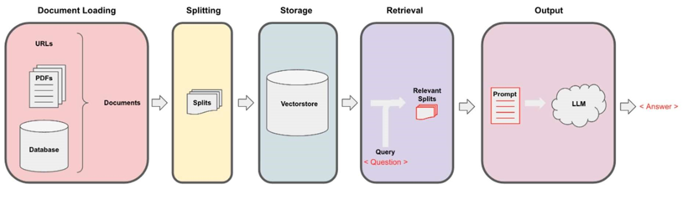

Slide 8
Langchain
LangChain is an innovative framework that is revolutionizing the way we develop applications powered by language models.
LangChain is a framework built to help you build LLM-powered applications
Langchain consist of few modules. As its name suggests, CHAINING different modules together are the main purpose of Langchain. The idea here is to chain every module in one chain and, at last, use that chain to call all modules at once.

Slide 9
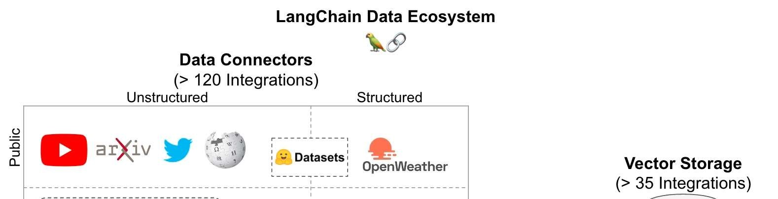
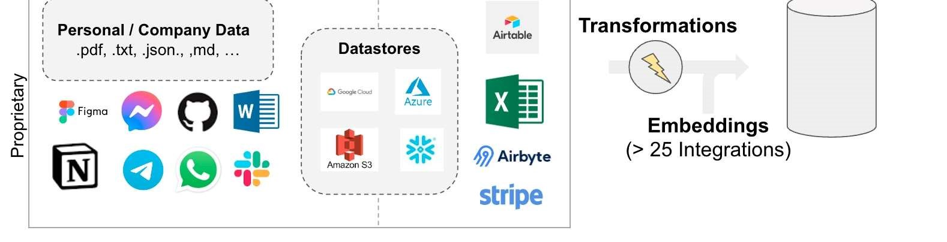

Slide 10
Streamlit
Streamlit is an open-source Python framework that makes it easy to create interactive web apps for data science and machine learning. It is a great choice for rapid prototyping, as it is simple to learn and use. Streamlit can be used to create a variety of web apps, including:
Data visualization apps
Machine Learning Apps
Dashboards

Slide 11
GROQ API
High-Performance AI: The Mixtral model leverages GROQ's high-performance computing, optimizing AI tasks like NLP and data processing for faster execution and efficiency.
Advanced Language Understanding: With deep contextual understanding, the Mixtral model excels in text generation and conversational AI, enhancing user interactions and analysis.
Scalable Real-Time Applications: Integrated with GROQ API, the Mixtral model supports real-time processing and scalability, making it ideal for large-scale AI applications.

Slide 12
Vector Database
Efficient Vector Search: Faiss is a high-performance vector database optimized for similarity search, enabling fast and efficient retrieval of nearest neighbors in large datasets.
Scalable and Flexible: Faiss supports millions of vectors, offering scalability and flexibility for handling extensive datasets in various AI and machine learning applications.
Real-Time Querying: Designed for real-time querying, Faiss delivers quick responses, making it ideal for applications requiring instant similarity search and recommendation systems.

Slide 13
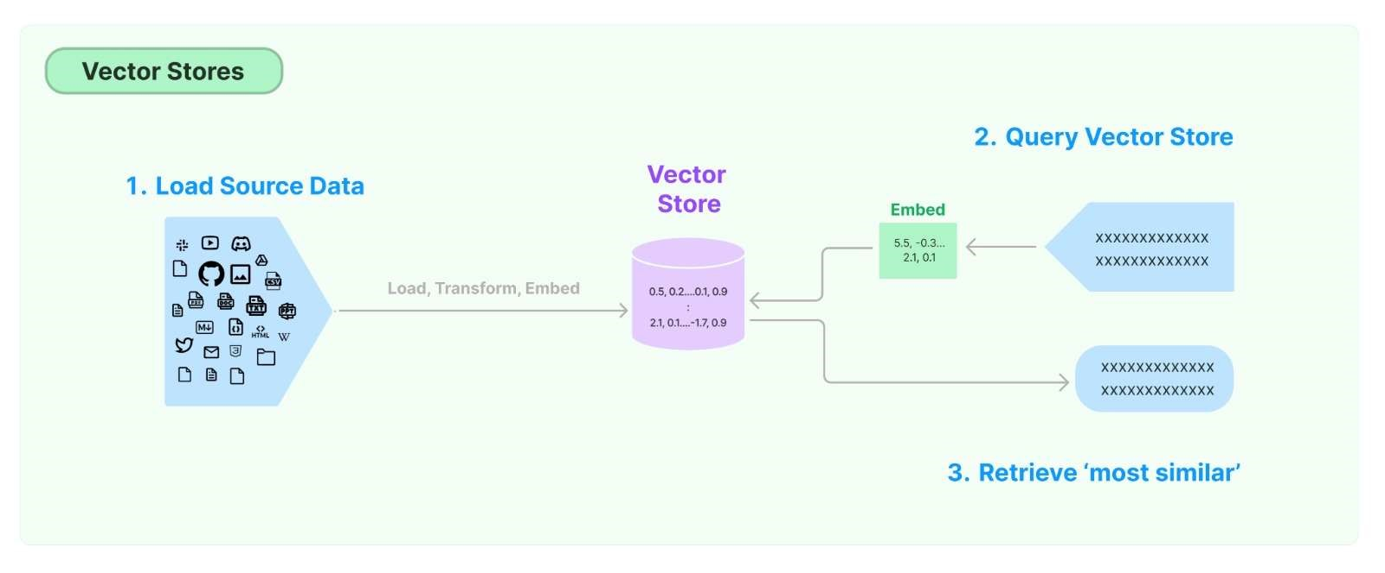

Slide 14
Working of Application
Load.
Load the .txt file into the application using the LangChain loader
def document_loader():
filename = "Dataset/RmluBOT.txt"
with open(filename, errors="ignore") as file:
contents = file.read()
return contents
Split the text data into chunks.
Splitting the text into the small chunks by using the ‘\n’, ‘\n\n’, ‘ ‘, etc.
char_splitter = RecursiveCharacterTextSplitter(
separators = ['\n', '\n\n', ' ', '. ', ', ', ''],
chunk_size = 1000,
chunk_overlap = 0.2
)

Slide 15
Working (Continue)
Create Embeddings of the chunks.
Used the HunggingFaceEmbeddingModel for embedding the chunks. It will help to store the data into the vector database.
model_name = "sentence-transformers/all-MiniLM-L6-v2"
embedding_fn = HuggingFaceEmbeddings(model_name=model_name)
vector_path = 'Vector_db/rmlu_Vector_db'
vector_db = FAISS.from_documents(documents=texts, embedding=embedding_fn)
vector_db.save_local(vector_path)
User Input.
Takes input from the user on the ChatBot UI, embed the text and compare the embeddings with the data stored in the vector database.
def RAG_Chain(query):
print("Generating the response...")
response = qa_conversation({"question": query})
return response.get("answer")

Slide 16
Working (Continue)
In backend, the application load the data, create chunks and convert the chunks into the embeddings.
We are using “ConversationBufferWindowMemory” for storing the responses and “ConversationalRetrievalChain” for the conversational chatting experience. By using this, our chatbot save the responses and answer the next queries by relating to the previous queries and answers.
Using GROQ API for mixtral-8x7b for getting correct responses for the user.
Used the Streamlit for UI creation and taking queries from the user.

Slide 17
Real Life Uses
Course Assistance: Help students find information on courses, schedules, and prerequisites. Assist in the course registration process.
Exam Support: Provide details on exam dates, locations, and special instructions.
Campus Facilities Finder: Guide users to the locations of campus facilities like libraries, labs, and sports area. Share information on available services such as counselling and health services.
General University Information: Users can ask general questions about the university, such as history, accreditation, and campus policies. The chatbot can provide information about admission procedures for prospective students.

Slide 18
Limitations
The system is still under development and can be improved in a number of ways. For example, the system could be made more accurate by using a larger and more diverse dataset of text. The system could also be made more efficient by using a faster vector database.
The system is currently only able to answer questions about the data available on the site, if the data updated or changed it will not able to update the information dynamically.
The system is currently only available in English. It would be useful to extend the system to be able to answer questions in Hindi.

Slide 19
Mentor:
Team:
Dr. Avadhesh Kumar Dixit
Devesh Mishra(20171)
Manas Barnwal(20130)
Priyanka(20138)

Slide 20
Thank You!

